Slide 1
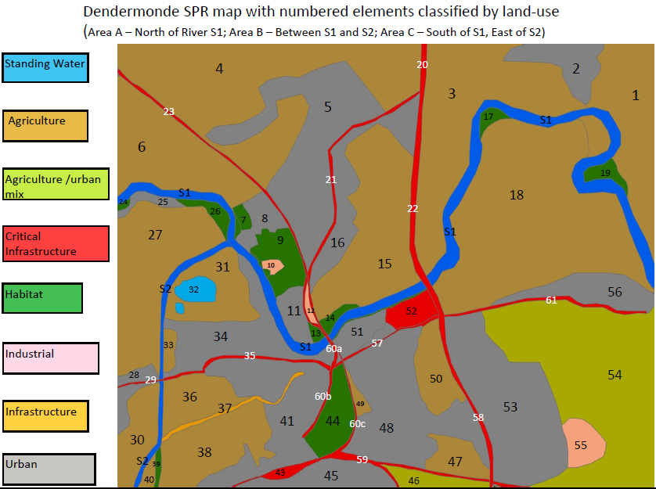
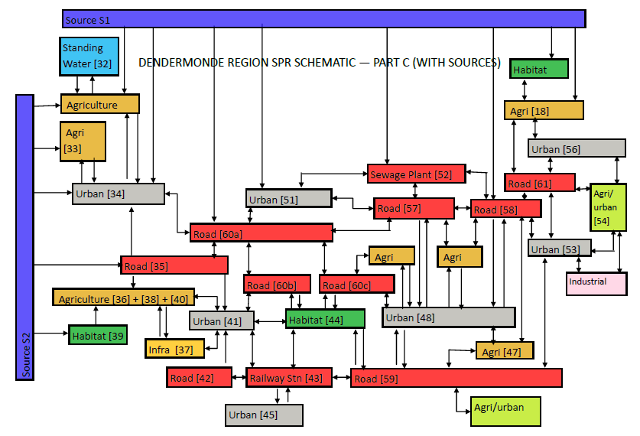
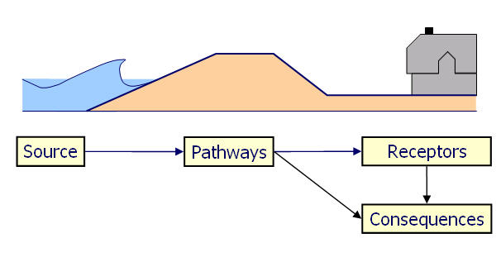
Innovative technologies for safer European coasts in a changing climate
A systems analysis of coastal flooding using the SPRC model
Problem Statement
Preliminary Work
Increasing rates of sea-level rise and concentration of coastal assets are likely to increase damages due to coastal flooding in future. Traditional coastal modelling works from the flood source outwards, estimating damage to receptors within the modelled floodplain. This method fails to pinpoint receptors critical to the health of the system. This has lead to oversights in coastal defence management with catastrophic flooding consequences such as in hurricane Katrina (USA), cyclone Sidr (Bangladesh) and storm Xynthia (France).
The simplistic version of the model shown in Fig 1 is developed into a more comprehensive description of the coastal flood system for the Dendermonde region of the Scheldt estuary, Belgium (Figure 2), one of the eight THESEUS case study sites. Based on land-use, it highlights possible connections between different elements. This analysis effectively illustrates the complexity of the system and the vulnerability in terms of connections of certain receptors.
Research Description
This PhD is being undertaken within the EU THESEUS project (www.theseusproject.eu) based on eight case study sites across Europe. The PhD tackles flood modelling starting from the receptors rather than the sources, to gain an understanding of the system prior to application of flood models. The coastal flood system is studied using a systems linkage diagram based on the Source-Pathway-Receptor–Consequence (SPRC) model (Fig 1).
Figure 2: The land-use map (left) and SPR Systems Linkage Diagram (right) for Dendermonde Town, Belgium.
The system diagram makes explicit prior to flood modelling several key points such as the interconnection between receptors, possibility of flooding from two directions and the possibility of flood propagation via the roads and railway. This can be used to selectively inform flood models. Further work will include development of system fault-trees for analysing flood risk and the effects of changes to elements on overall system health.
(e.g. waves)
(e.g. dunes)
(e.g. people flooded)
Figure 1: The Source – Pathway – Receptor – Consequence (SPRC) Conceptual Model
Research impact
Coastal flood modelling until recently has been unable to pinpoint receptors critical to the health of the flood system and their relation to surrounding elements. This research will create a tool to facilitate an understanding of coastal flood systems in terms of the elements within, their inter-connections with one another and their effect on the health of the system and its constituents. The research is funded by the EU THESEUS project and the preliminary concept has been presented at the EGU 2011 conference .
www.southampton.ac.uk
Siddharth Narayan (PhD Student supervised by Prof. Robert Nicholls and Dr. Derek Clarke), Faculty of Engineering and the Environment. Funded by the EU FP7 THESEUS project. sn3g08@soton.ac.uk

