Slide 1







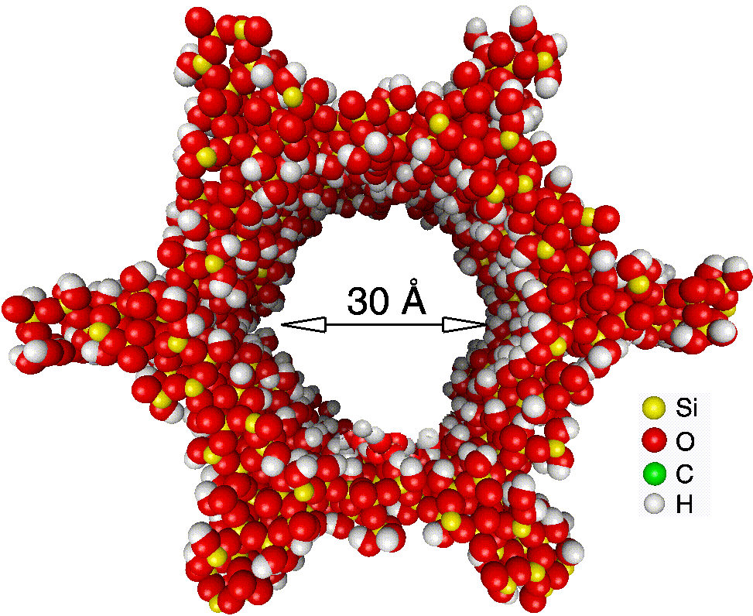
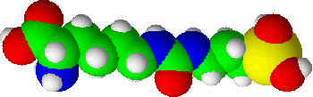

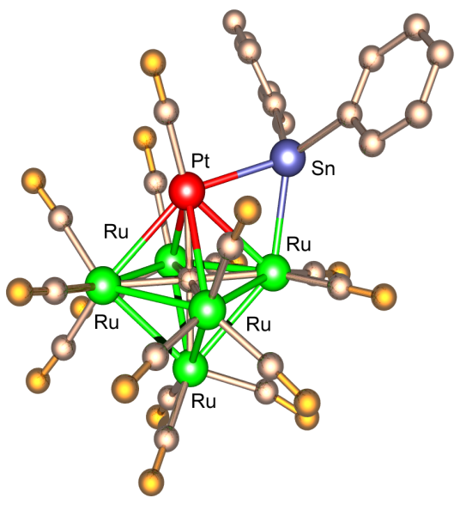

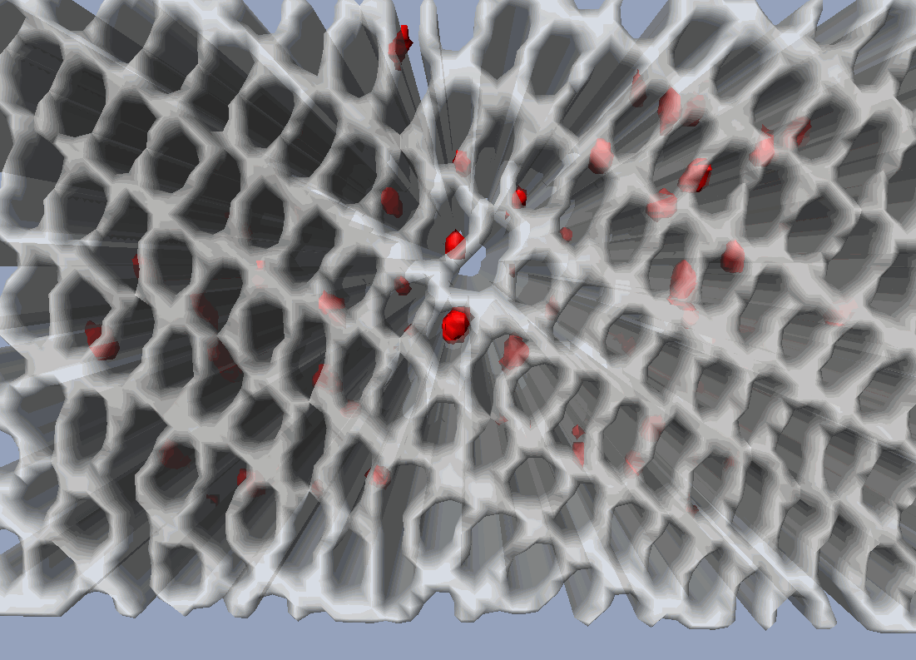
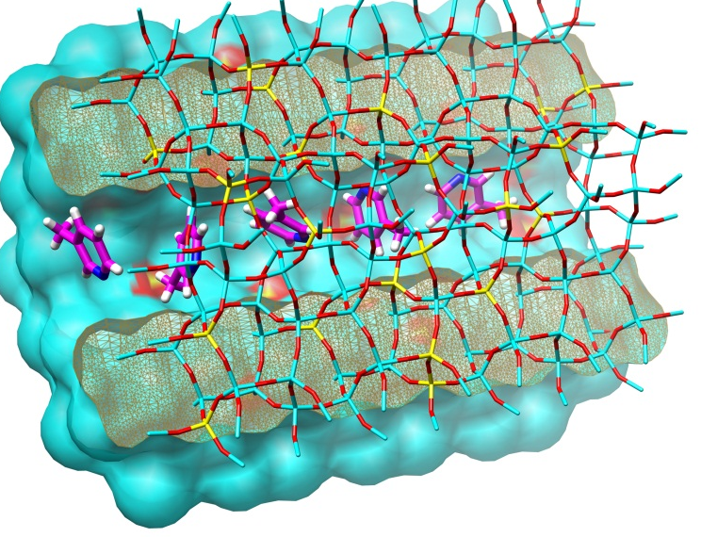
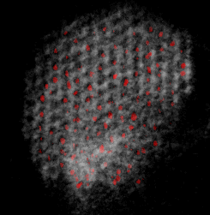
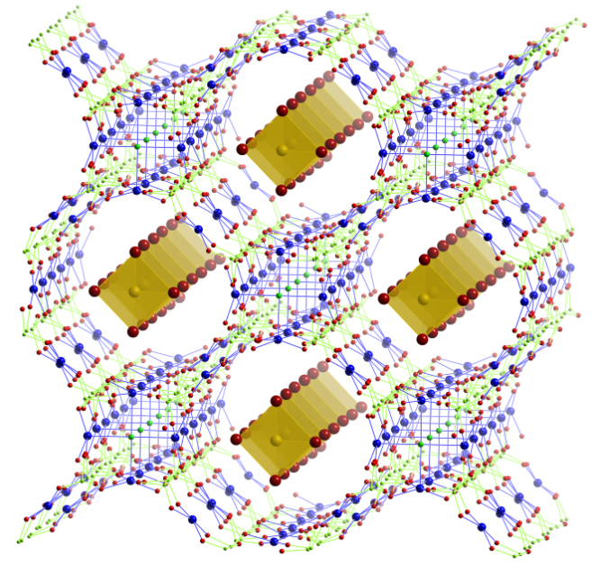
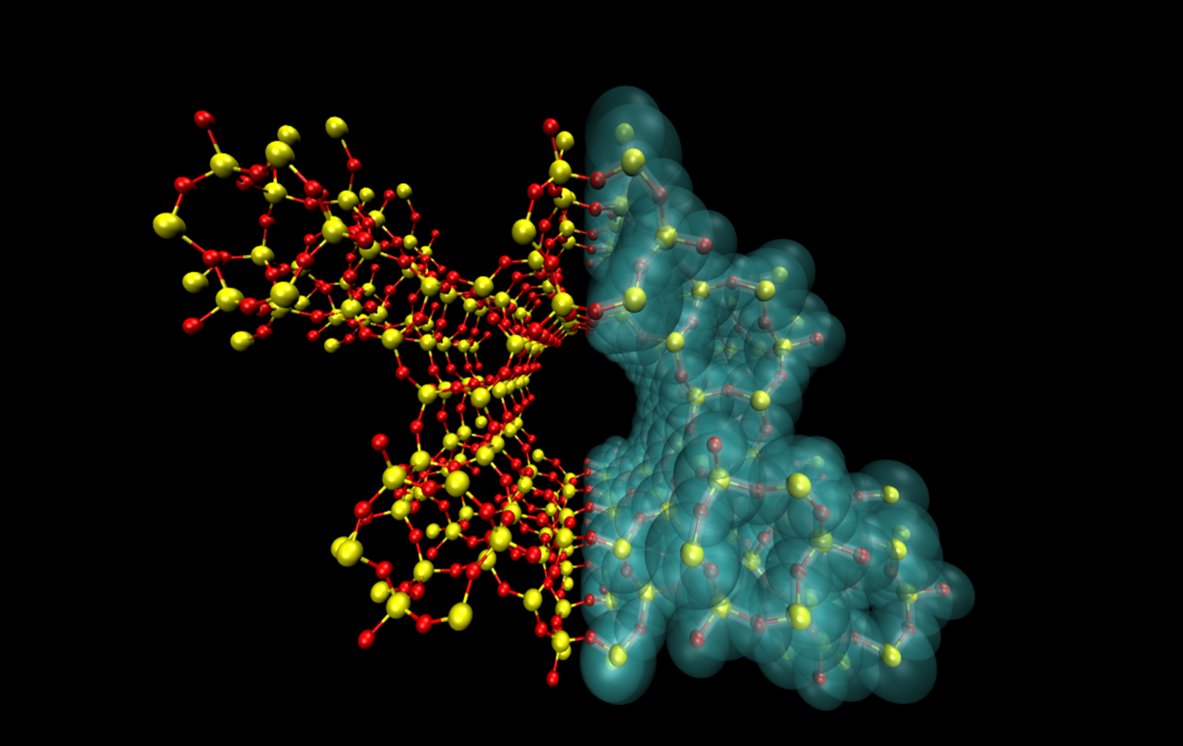
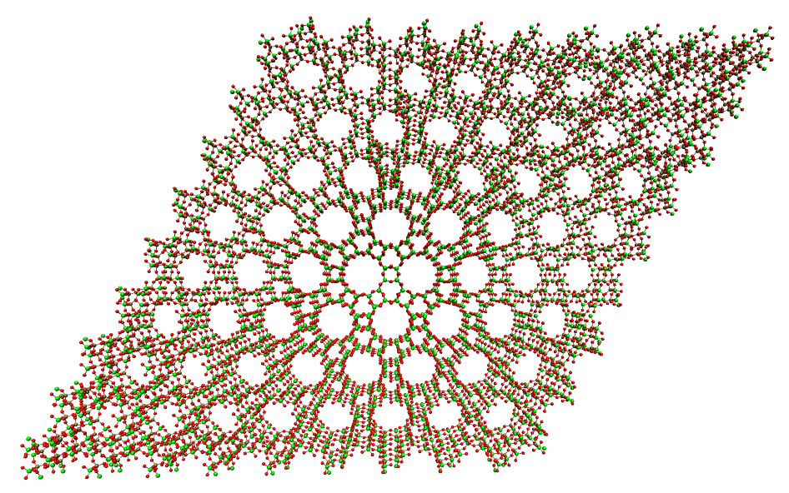
Sustainable Catalysis for Marine Renewable Energy
Christopher Hinde, David Xuereb, Matthew Potter, Robert Raja*
R.Raja@soton.ac.uk;
http://www.soton.ac.uk/chemistry/about/staff/rr3.page
Engineering Sustainable Catalysis
Capitalising on Catalytic Synergy
Nature of framework and orientation of pore architecture (channels vs. cages) for controlling molecular transport
Precise location, electronic configuration and coordination geometry of active centres
Proximity of active sites for enabling transition-states and mechanistic pathways
Discrete single-sites for enhanced catalytic turnovers
Single-sites with specific function (e.g. redox vs. acid properties) for targeted catalysis
Designing active sites with an intrinsic role: e.g. substrate vs. oxidant binding for enhancing rates, facilitating diffusion, stabilizing transition-states and maximising atom efficiency (reduce waste).
Industrial Collaborations
Greener Nylon
Terephthalate-based fibres
Adipic Acid
ε-Caprolactam
Bio-ethanol dehydration
Cascade Reactions and Flow Chemistry
Clean and Sustainable Chemistry
Marine Renewable Energy
Fine-Chemicals
Pharmaceutical Intermediates
Porous Molecular Frameworks: Design Strategy
Designing novel framework structures (zeolites, AlPOs, MOFs, ZIFs) with tuneable pore architectures
Isomorphous substitution of framework anions and cations with catalytically active transition-metal entities
Take advantage of pore aperture for shape-, regio- and enantio-selectivity
C
O
Si
H
N
Anchored Organocatalyst on Mesoporous Silica
Properties
Hybrid/hierarchical architectures
Wide-ranging chemical properties
Redox Catalysis (selective oxidations, epoxidation)
  Acid Catalysis (Alkylations, isomerisations, dehydration)
  Bifunctional and cascade reactions
  Oxyfunctionalisation of alkanes and aromatics (C-H activation)
High thermal stability/recyclability
Clean drinking water
Nanoparticle Catalysts from Cluster Precursors
Renewable energy
Catalysis
CO₂ capture
[001]
surface render
reconstruction
Catal. Sci. Technol., 2011, 1, 517-534.
Microporous Architectures for Shape-Selective Catalysis
Nanoparticle Catalysts for Converting Sugars to Nylon
3D Tomogram generated from 2D HAADF-TEM images
Chem. Eur. J., 2010, 16, 8202-8209
Marine Energy and Maritime Engineering
Hydrogen Energy through Photocatalysis of Sea-Water
Functionalised porous framework materials for high-efficiency catalysis (MOFs, Zeolites)
Photocatalytic splitting of water for H₂ and O₂ generation
Harvesting marine-energy for potential impact on H₂ economy
Synergistic behaviour in metal-doped frameworks for enhancing catalytic efficiency (by orders of magnitude) compared to conventional systems
Photo-catalytic Oxidation of Water
H₂Storage and CO₂ capture
Gas release mechanisms
Selective Catalytic Reduction (SCR) of Exhaust Waste
Developing marine exhaust-gas cleaning technologies
SCR for removal of NO_{x}, SO_{x}, VOCs and particulates from diesel engines in ships
Exploitation of synergy for enhancing rates and maximising selectivity
Selectivity induced by pore size and hierarchical frameworks
MOF-500 - [(Fe₃O)₄ (SO₄)₁₂(BPDC)₆ (BPE)₆]
Square planar Au anions in channels of copper chloropyrophosphates. [Cu₆(P₂O₇)4Cl₃][MX₄]
Gas Storage and Carbon Capture
High surface-area porous materials for increased adsorbtion potentials
Hybrid inorganic-MOF frameworks for combined properties
Spillover potential and alkali earth metal doping to maximise gas-storage properties
Multifunctional frameworks can facilitate carbon capture and its subsequent utilisation in consecutive chemical processes
MOFs and ZIFS
Hierarchical formation of pores (4 different cavity sizes)
High tunability from organic linkers and metal centres
Potential for functionalization and selectivity control
Metal Fluorophosphates
Stabilization of complex anions in open-framework phosphate architectures (M = Mn³⁺, Fe³⁺, Co²⁺, Cu²⁺ etc.
High fluorine content
Multi-metallic combinations
Synergy
Chem. Commun., 2011, 47, 517–519
Novel Framework Architectures for Enhanced SCR applications in Marine Engineering
Renewable Feedstocks for Biodiesel & H2 Generation
Hybrid Catalysts for Biomass Conversions to Selective Chemical Intermediates
Academic & Industrial Partnership Programs
Renewable Transport Fuels
Bio-Ethanol and Biomass Conversions
Hybrid Biofuels (2nd and 3rd Generation)
Biodiesel & Bioenergy
Hydrogen Economy
Alternatives to PGM Catalysts
Industrial Hydrogenations
Low-Temperature Acid-Catalysis
Renewable Polymers
Multifunctional Hierarchical Architectures for Biodiesel Production
A hybrid approach for biodiesel production and parallel glycerol conversion (tandem reaction)
Acid Sites:
Solid-acid active centres for the conversion of vegetable oils to FAMES
Nanoparticle Catalyst:
Simultaneous glycerol transformation to 1,3-propandiol
AFI Micropores
7.3 Å
(alternative to bioethanol)
Mg^{II}Si^{IV}AlPO-5
Bio-Ethanol/Propanol
Synergy
Contacts:
Dr. Robert Raja
University of Southampton
T: +44 2380 592144;
R.Raja@soton.ac.uk
http://www.soton.ac.uk/chemistry/about/staff/rr3.page
(polymers & plastics)
Non-ordered mesopores
~20 Å
Ethene
Dalton Trans., 2012, 41, 982-989
Chem. Commun., 2010, 46, 2805-2807

