Slide 1

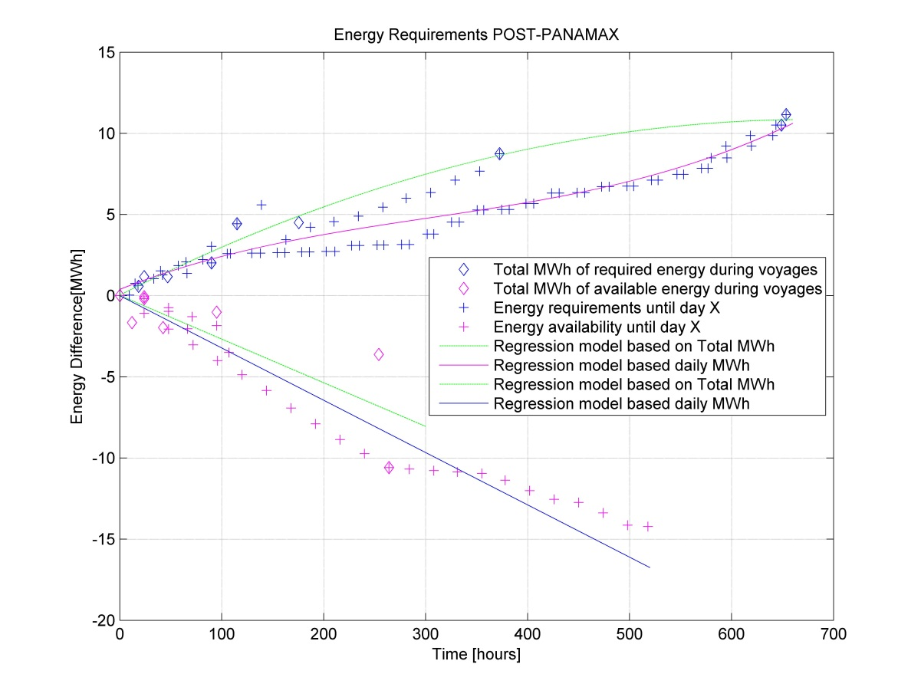
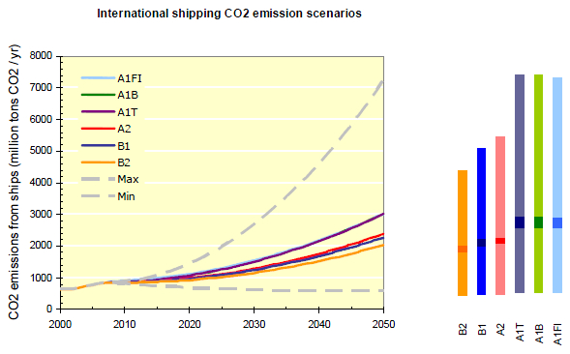
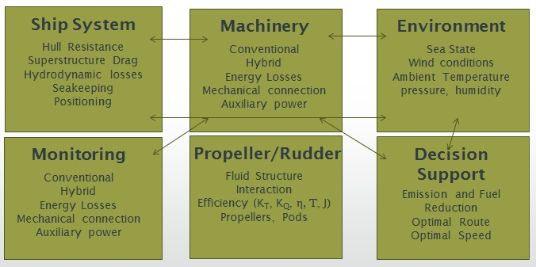
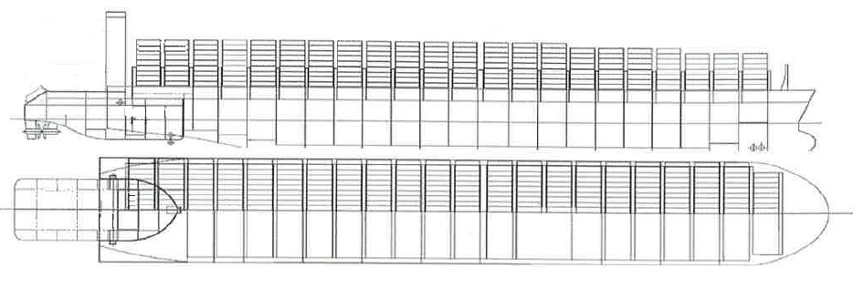
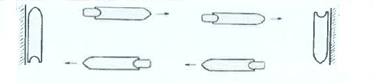


Fluid Structure Interactions Research Group
Low Carbon and Hazardous Emissions Shipping
Eleftherios K. Dedes – ed3g09@soton.ac.uk
Lloyd’s Register - Foundation Propondis
Supervisors – Prof. Stephen R. Turnock and Dr Dominic A. Hudson
Motivation and Aim
Conclusions to date
“The whole is more than the sum of the parts” – Aristotle.
This study is based on the systemic approach of propulsion system (Systems engineering) instead of the traditional optimisation of single components.
Ultimate objective: Provide an alternative reliable, economically feasible, marine propulsion system to reduce CO₂, SO_{x}, NO_{x} and particle emissions from ships.
The project investigates the potential of large scale application of Nuclear propulsion using small portable reactors and the installation of energy storage devices for modular operation and controlled energy flow.
Currently, a lot of work has been done in large 2 Stroke engines to reduce SO_{x}, NO_{x} using external means, like Selective Catalytic Reaction, Scrubbing but also by optimizing the combustion and the operation of the engines such as valve timing, variable turbine blade area etc.
However, domestic shipping and fishing activity bring emission totals to 1050 million tonnes of CO₂, or 3.3% of global anthropogenic CO₂ emissions. Despite the undoubted CO₂ efficiency of shipping in terms of grammes of CO₂ emitted per tonne-km it is recognised within the mari-
time sector that reductions in these totals must be made.
Shipping is responsible for a large percentage share of NO_{x} (~37%) and SO_{x} (~28%) emissions
Due to the increasing growth of marine the transportation, immediate action is required to stop the climate change
The current state of play is ready for the adoption of new technologies including the nuclear propulsion, combined energy cycles and advanced heat recovery systems.
The combination of such technologies has not been assessed and optimised yet.
Fuel savings depending on storage system, vessel condition and vessel type, can reach up to:
111,538 tonnes in NO_{x}
74,460 tonnes in SO_{x}
4,162,7 tonnes in CO₂
The above represent a maximum 22.5% reduction in the dry bulk sector and 2.8% of the world’s fleet emissions.
The economic feasibility is dependent on the capacity and power of storage medium.
Sodium Nickel Chloride Battery is more economical feasible option
Vanadium redox Flow batteries have high potential and it is promising technology
Depending on vessel type fuel savings can exceed 1m $ per year
Cost of construction drops
Initial investment cost remains high
Internal Rate of Return varies from 4.3% - 44.7%
Figure 4: Energy Storage Requirements (left) and Energy fluctuations during Laden and Ballast voyages (right).
Figure 1: Predicted emissions of the shipping sector according to I.M.O. 2nd Greenhouse emission study.
Energy Requirements in Bulk carriers have no flat profile (as it was believed)
Simulator model accuracy is based on the selected time-step or the amount of given data
2-stoke Mechanical Diesel part load optimised and Hybrid propulsion gives notable gains
Electric propulsion is not suitable for bulks as conversion losses are higher than the fluctuations in Main Engine’s fuel efficiency
Hybrid Propulsion is technically feasible without affecting the basic ship dimensions
Nuclear Pusher/ Barge system can be achieved using the same principles with the shore power connection (“Cold Ironing”)
Hybrid Propulsion is not necessary when sailing in open sea as Nuclear reactor has rapid load change (5%/ sec. for change up to 15%) without affecting the efficiency
Ship Simulation (Modular Block Implementation )
A scalable and modular approach in MATLAB/Simulink environment was developed.
Each block represents machinery comp, weather, engine, ship model
  Hull Resistance (Holtrop – Mennen method, Lap – Keller methods)
  Added Resistance (Aertssen, Kwon methods)
  Wind Resistance (Isherwood, Blendermann methods)
  Wageningen Series open water performance method
  Open thermodynamic system properties (Control Volume Theory)
  Battery models, using Kinetic Energy approach (Manwell, McGowan)
  Heat Transfer (for usage in High Temperature battery applications)
Figure 5: Schematic of two out of total four proposed hybrid propulsion solutions showing conversion efficiencies.
Future planned work
Code implementation for creation of random weather conditions in order to assess the machinery layout feasibility and verify potential savings in fuel consumption
Systems engineering by:
  Concepts of different propulsion systems such as steam, electrical, conventional Diesel
  Risk and safety assessment for each module of the propulsion system
Contribute to the Gold based Rules for merchant marine nuclear propulsion
Figure 2: Simulator Major Block Description (top) and Engine-Hull simulation schematic (down).
Nuclear Vessel Concepts
A pusher/ barge concept offers:
Reactor away from ports (>40nm)
Well guarded propulsor
Easy dry-docking for barge/pusher
Can be leased by ship-owners
No need for state/ Country regulations
Hybrid Electric propulsion offers to the Barge self-propulsion capability using energy storage when in national waters and while in open sea, the electricity is supplied by the pusher’s Nuclear reactor
Acknowledgments
The authors wish to thank Lloyd’s Register and Foundation Propondis for the financial support of the PhD, the two Greek Maritime companies which prefer to stay anonymous and Carnival Cruises and Plc UK for giving access to the operational data and technical specifications of their fleet.
References (Eleftherios K. Dedes, Dominic A. Hudson, Stephen R. Turnock )
Assessing the potential of hybrid energy technology to reduce exhaust emissions from global shipping, Energy Policy 40, p.p. 204-218, 2012
Technical feasibility of hybrid propulsion systems to reduce emissions from bulk carriers, under review, Transactions of RINA.
Possible Power Train Concepts for Nuclear Powered Merchant Ships. LCS 2011 conference, Glasgow, Vol. 1 p.p. 263-273, University of Strathclyde, 2011.
Design of Hybrid Diesel-Electric Energy Storage Systems to Maximize Overall Ship Propulsive Efficiency, 11th PRADS conference R.J. Brasil, Vol. 1 p.p. 703-713, COPPE UFRJ, 2010
Figure 3: Nuclear Pusher- barge system (top) and schematic of potential commercial chain using pushers and barges (down).
FSI Away Day 2012

