Slide 1
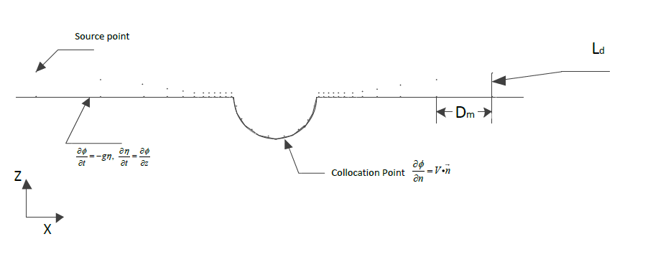
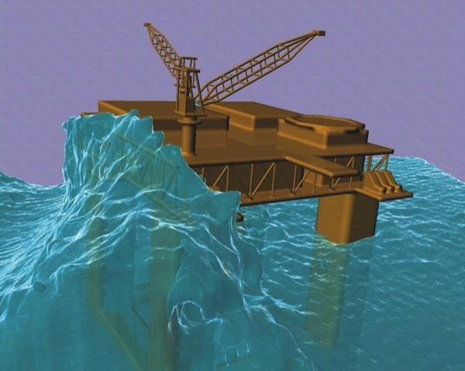
Fluid Structure Interactions Research Group
Nonlinear Hydrodynamic Analysis of Floating Structures Subject to Ocean Environments
Aichun Feng. Supervisors: Dr Zhimin Chen and Professor Jing Tang Xing
Faculty of Engineering and the Environment, University of Southampton, UK.
A.Feng@soton.ac.uk
Background
The free-surface is divided into inner and outer domain where source is evenly distributed in the former and exponentially increased in the latter. The nondimensional desingularized distance is given by:
An accurate prediction of wave-induced motions and loads is vital in ship and offshore structure designs.
Practical nonlinear environments, especially the second-order factors, generate significant load effects on the floating structures.
Several numerical methods and commercial software are available but not robust enough particularly for the nonlinear analysis.
Objectives
To understand the mechanism of wave-body interaction based on the potential theory.
To predict hydrodynamic loads and responses of a floating body in nonlinear waves.
To develop an efficient numerical algorithm and Fortran codes using Rankine source technique and Euler-Lagrangian formulation.
Figure 2: 2-D Rankine source method computation model
Initial Result
The initial results for a 2-D circular cylinder in unbound domain show a good agreement between the panel method and analytical expression which can be expressed as:
$$φ=−URsinθ$$
The cylinder is divided into 12, 24 and 36 panels respectively.
Figure 1: Nonlinear wave excitations on floating structure
Problem Formulation
Figure 3: The comparisons of panel method and analytical expression
The governing equation for the motion of a rigid body in the time domain can be expressed as follows:
Under the effect of free-surface, the computation of the added mass of a semi-circular cylinder is quite stable. The convergence phenomenon is illustrated in Figure 4, where x-axis represents the number of nodes distributed on the free surface.
The results indicate that 200 nodes are enough for convergence.
The dynamic and kinematic nonlinear free-surface boundary conditions are listed below:
Figure 4: Convergence of added mass
Future Work
Euler-Lagrange time stepping procedure
1. A mixed boundary value problem is solved for velocity potential at a fixed instant .
2. The free surface boundary condition can then be stepped forward in time by Lagrangian formulation:
2-D floating body hydrodynamic evaluation will be extend further to consider nonlinear free-surface and body-exact condition effects.
Rubber-band numerical method and Euler-Lagrange time stepping procedure will be applied in the numerical simulation.
A further numerical method will be developed to simulate 3D wave-body interactions.
References
Numerical Methodology
1. Zhang, X.S., Large amplitude ship motion computations using a timedependent body geometry. Ph.D Dissertation, The University of Michigan, 2007.
2. Longuet-Higgins, M.S., Cokelet, C. D., The deformation of steep surface waves on water, I a numerical method of computation, Proceedings of the Royal Society A350,(1976), 1-26.
The Rankine source method can be extended to simulate nonlinear surface waves by distributing desingularized sources on the free surface.
The body surface boundary condition varies nonlinearly with time step to capture the nonlinear effect of body condition.
FSI Away Day 2012

