Slide 1
Online content regulation at the crossroads of automation and injunctions: the way forward
Southamton, 20.11.2017
Civil procedure ensuring effective remedies

Slide 2
Karmen Turk
Lecturer, University of Tartu
Attorney-at-law / Partner TRINITI Law Firm
Expert, Council of Europe
karmen.turk@triniti.ee

Slide 3
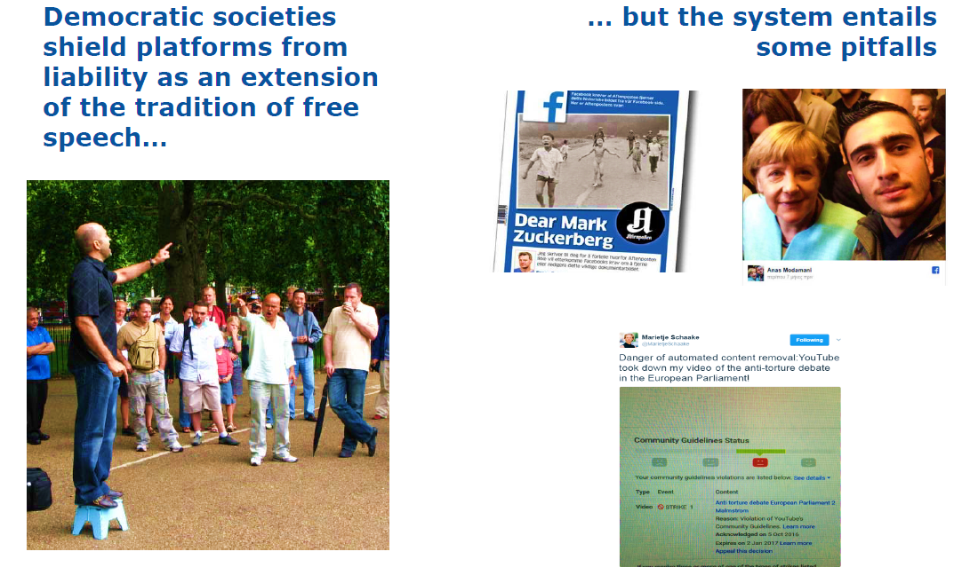

Slide 4
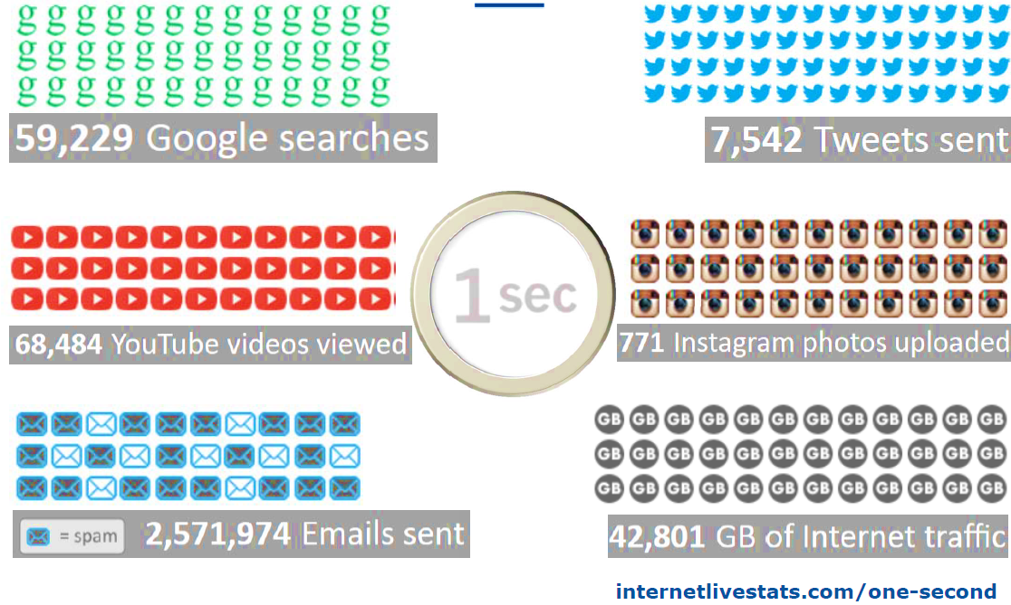
Notes:
How to find a rule of law from this reality?
Copytriht Directive proposal seems not a tool striking fair balance
Impunity does not seem to strike a fair balance
According to OSCE, FB deletes 66000 posts/week
Measures without due process seem notto strike fair balance?

Slide 5
Managing online content in accordance with the rule of law?
Jurisdiction
Procedure
Remedies
Notes:
Remedies:
ensured by the säte
accepted by private sector
Jurisdiction
Who can claim what, where
Procedure
Needs to support the agreed remedies and jurisdiction and ensure quick, affordable relief

Slide 6
Remedies
Check?

Slide 7
Remedies
Article 13 ECHR – effective, prefereably judicial remedy
States must protect against human rights abuse within their territory and/or jurisdiction by third parties, including business enterprises
  ECHR, Silver and Others v. the United Kingdom judgment of 25 March 1983

Slide 8
How does it work online???
UN Guiding Principles: Content, Rationale and Usefulness
State duties
Remedies
Corporate duties
Prof. John Ruggie: Special Representative appointed by UN Human Rights Council to investigate Business and Human Rights in 2005 in light of failure of norms
Produced a Framework in 2008 with three prongs:
Notes:
Part I: State duty to protect individuals from corporate violations at international law
Improve legal framework and create monitoring mechanisms
Drive to improve domestic regulation of human right
Part II: Corporate obligations to respect human rights:
DO NO HARM
May require positive steps like instituting anti-discrimination policy
May in some instances require positive duties of companies where they are sole provider of services and where context requires provision of health, education
Involves all rights recognised at international level
Part III: Access to Remedies
Investigation and punishment where wrong-doing
Judicial and Non-Judicial mechanisms proposed
Grievance mechanisms within company: hotlines, advisory services for complainants, mediators
Identify potential violations early
Should not impact on ability to access other forms of redress through courts.

Slide 9
Remedies
Extrajudicial renovation
Judicial protection
investigation,
explanation,
response,
correction,
apology,
content renewal,
access renewal; and
compensation.
compulsory obligations to act
compulsory obligations to refrain from doing
compensation
criminal prosecution
Notes:
Please take a look in the users rights recommendation and name them!

Slide 10
Jurisdiction
Check?

Slide 11
Jurisdiction till 2017 in EU
Article 7(2) of Regulation No 1215/2012
‘Special jurisdiction’
  ‘A person domiciled in a Member State may be sued in another Member State:
  (2) in matters relating to tort, delict or quasi-delict, in the courts for the place where the harmful event occurred or may occur’.
    7 March 1995, Shevill and Others, C‑68/93
    3 October 2013, Pinckney, C‑170/12
    25 October 2011, eDate Advertising and Others,
    C‑509/09 and C‑161/10
    3 October 2013, Pinckney, C‑170/12
    22 January 2015, Hejduk, C‑441/13
Difference in:
Territorial and universal claims
In treatment of natural and legal persons
Notes:
7 March 1995, Shevill and Others, C‑68/93
In that regard, the Court of Justice has previously held that injury caused by a defamatory publication to the reputation and good name of a legal person occurs in the places where the publication is distributed and in which the victim claims to have suffered injury to its reputation
In that regard, the Court has held, in relation to actions seeking compensation for non-material damage allegedly caused by a defamatory article published in the printed press, that the victim may bring an action for damages against the publisher before the courts of each Member State in which the publication was distributed and where the victim claims to have suffered injury to his reputation, which have jurisdiction to rule solely in respect of the harm caused in the Member State of the court seised
25 October 2011, eDate Advertising and Others, C‑509/09 and C‑161/10
In the specific context of the internet, the Court has, nonetheless, ruled, in a case relating to a natural person, that, in the event of an alleged infringement of personality rights by means of content placed online on a website, the person who considers that his rights have been infringed must have the option of bringing an action for damages, in respect of all the harm caused, before the courts of the Member State in which the centre of his interests is based
3 October 2013, Pinckney, C‑170/12
Nonetheless, the referring court adds that, unlike an intellectual and industrial property right, whose protection is limited to the territory of the Member State in which that right is registered, the rights that have allegedly been infringed in the present case are not, by their nature, rights that can only be protected within the territory of certain Member States
22 January 2015, Hejduk, C‑441/13
That rule of special jurisdiction is based on the existence of a particularly close connecting factor between the dispute and the courts of the place where the harmful event occurred or may occur, which justifies the attribution of jurisdiction to those courts for reasons relating to the sound administration of justice and the efficacious conduct of proceeding

Slide 12
Jurisdiction post 2017
Natural and legal persons treated equally
  17 October 2017, Bolagsupplysningen, C‑194/16:
    legal person claiming that its personality rights have been infringed by the publication of incorrect information concerning it on the internet and by a failure to remove comments relating to that person can bring an action for rectification of that information, removal of those comments and compensation in respect of all the damage sustained before the courts of the Member State in which its centre of interests is located.
Notes:
Article 7(2) of Regulation No 1215/2012 must be interpreted as meaning that a legal person claiming that its personality rights have been infringed by the publication of incorrect information concerning it on the internet and by a failure to remove comments relating to that person can bring an action for rectification of that information, removal of those comments and compensation in respect of all the damage sustained before the courts of the Member State in which its centre of interests is located.
When the relevant legal person carries out the main part of its activities in a different Member State from the one in which its registered office is located, that person may sue the alleged perpetrator of the injury in that other Member State by virtue of it being where the damage occurred.

Slide 13
Claims to be allowed till 2017
Mosaic therory
  25 October 2011, eDate Advertising and Others (C‑509/09 and C‑161/10:
    Court held that the person who considers that his rights have been infringed may also, instead of an action for damages in respect of all the harm caused, bring his action before the courts of each Member State in whose territory content placed online is or has been accessible, which have jurisdiction only in respect of the harm caused in the territory of the Member State of the court seised.
Notes:
it is true that, in paragraphs 51 and 52 of the judgment of 25 October 2011, eDate Advertising and Others (C‑509/09 and C‑161/10, EU:C:2011:685), the Court held that the person who considers that his rights have been infringed may also, instead of an action for damages in respect of all the harm caused, bring his action before the courts of each Member State in whose territory content placed online is or has been accessible, which have jurisdiction only in respect of the harm caused in the territory of the Member State of the court seised.

Slide 14
Claims to be allowed post 2017
Entirety of claims:
  17 October 2017, Bolagsupplysningen, C‑194/16:
    in the light of the ubiquitous nature of the information and content placed online on a website and the fact that the scope of their distribution is, in principle, universaal, an application for the rectification of the former and the removal of the latter is a single and indivisible application and can, consequently, only be made before a court with jurisdiction to rule on the entirety of an application for compensation for damage and not before a court that does not have jurisdiction to do so.
Notes:
48 However, in the light of the ubiquitous nature of the information and content placed online on a website and the fact that the scope of their distribution is, in principle, universal (see, to that effect, judgment of 25 October 2011, eDate Advertising and Others, C‑509/09 and C‑161/10, EU:C:2011:685, paragraph 46), an application for the rectification of the former and the removal of the latter is a single and indivisible application and can, consequently, only be made before a court with jurisdiction to rule on the entirety of an application for compensation for damage pursuant to the case-law resulting from the judgments of 7 March 1995, Shevill and Others (C‑68/93, EU:C:1995:61, paragraphs 25, 26 and 32), and of 25 October 2011, eDate Advertising and Others(C‑509/09 and C‑161/10, EU:C:2011:685, paragraphs 42 and 48), and not before a court that does not have jurisdiction to do so.
49 In the light of the above, the answer to the first question is that Article 7(2) of Regulation No 1215/2012 must be interpreted as meaning that a person who alleges that his personality rights have been infringed by the publication of incorrect information concerning him on the internet and by the failure to remove comments relating to him cannot bring an action for rectification of that information and removal of those comments before the courts of each Member State in which the information published on the internet is or was accessible.

Slide 15
Estonian civil procedure: securing an action without submitting an action

Slide 16
Estonian example
§ 377. Basis for securing action
    The court may secure an action at the request of the plaintiff if: there is reason to believe that failure to secure the action may render enforcement of a court judgment difficult or impossible.
      - If enforcement of a court judgment will evidently take place outside of the European Union and the enforcement of court judgments is not guaranteed on the basis of an international agreement, it is presumed that failure to secure the action may render enforcement of the court judgment difficult or impossible.
English versioon: https://www.riigiteataja.ee/en/eli/ee/524072017001/consolide

Slide 17
Provisional regulation
In order to secure an action which object is not a monetary claim against the defendant, the court may:
  provisionally regulate a disputed legal relationship
  if this is necessary for the prevention of significant damage or arbitrary action or for another reason.
English versioon: https://www.riigiteataja.ee/en/eli/ee/524072017001/consolide
Notes:
In order to secure an action which object is not a monetary claim against the defendant, the court may:
provisionally regulate a disputed legal relationship and, above all, the manner of use of a thing,
if this is necessary for the prevention of significant damage or arbitrary action or for another reason.

Slide 18
No need to submit an action?
§ 382. Securing of action without filing action
    (1) The court may also secure an action based on a petition before the action is filed.
English versioon: https://www.riigiteataja.ee/en/eli/ee/524072017001/consolide

Slide 19
Adjudication
§ 384. Adjudication of petition for securing action
  The court adjudicates, by a reasoned ruling, a petition for securing an action not later than on the working day following the date of submission of the petition.
  The court may adjudicate the petition for securing an action at a later time if it wishes to hear the defendant beforehand.
English versioon: https://www.riigiteataja.ee/en/eli/ee/524072017001/consolide

Slide 20
Costs?
50 euros state fee
RISK: compensation for damage caused by securing of action
Notes:
(1) The party who applied for securing an action shall compensate for the damage caused to the other party by the securing of the action, if:
1) a court decision on refusal to satisfy or hear the secured action enters into force, or if the proceeding in the matter is terminated on any other grounds except due to the approval of a compromise of the parties;
2) it becomes evident that no claim for securing the action or no cause for securing the action existed at the time of securing the action;
3) a ruling on securing the action which was made before the action was filed is annulled due to the reason that the action was not filed on time.
(2) A security for compensation for damage likely to be caused by securing an action which is imposed on the person who requested the securing of the action is returned to such party if the other party has not filed an action for compensation for damage within two months as of the time specified in subsection (1) of this section.

Slide 21
Room for improvement
A lot ☺
  Temporary injunction → a permanent injunction
  Obligation to submit a claim → no obligation
    no obligation to submit an action if the other party does not argue against the securing of the claim
  Freeform writing → standardization
    Form based petitions with a word-limit on reasoning
English versioon: https://www.riigiteataja.ee/en/eli/ee/524072017001/consolide

Slide 22
Thank you!!!

